Slide 1






The Gap in Soil Intelligence in Nepal
Farmers in Nepal lack fast, affordable, and actionable soil insights. As a result, decisions are made with a yield-first mindset rather than optimizing for crop nutrition and long‑term soil health.
Slow
Expensive
Limited Access
Yield-focused Decisions
Lab turnaround creates delays between sampling and action — decisions happen too late in the season.
Typical soil analysis costs ~Rs. 2000, a major barrier for smallholders and repeated testing.
Rural communities have few nearby labs and weak logistics for sample transport.
Without nutrient-focused guidance, management prioritizes short-term yield instead of crop nutrition or soil recovery.
Idea line: Farmers lack fast, affordable, and actionable soil insights.

Slide 2

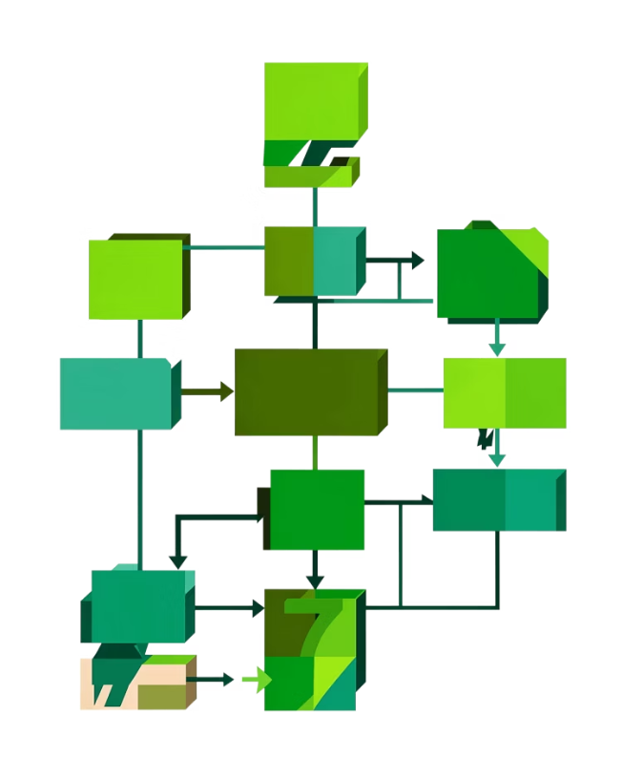


Mato: Smart Soil Intelligence System
NutriMap converts measured soil parameters into instant, nutrient-focused recommendations. It is designed as an accessible, low-cost tool for Nepali farmers and a scalable analytics platform for agribusinesses and government programs.
Inputs
Processing
Outputs
pH, N–P–K levels, soil moisture, and temperature (from sensors or simple field tests).
Rule-based engine maps measures ranges and nutritional recommendations using established standards.
Instant crop suggestions, nutrient-focused advice, and field-level guidance deliverable via app, SMS.
Idea line: We convert soil data into instant, nutrient-focused decisions.

Slide 3
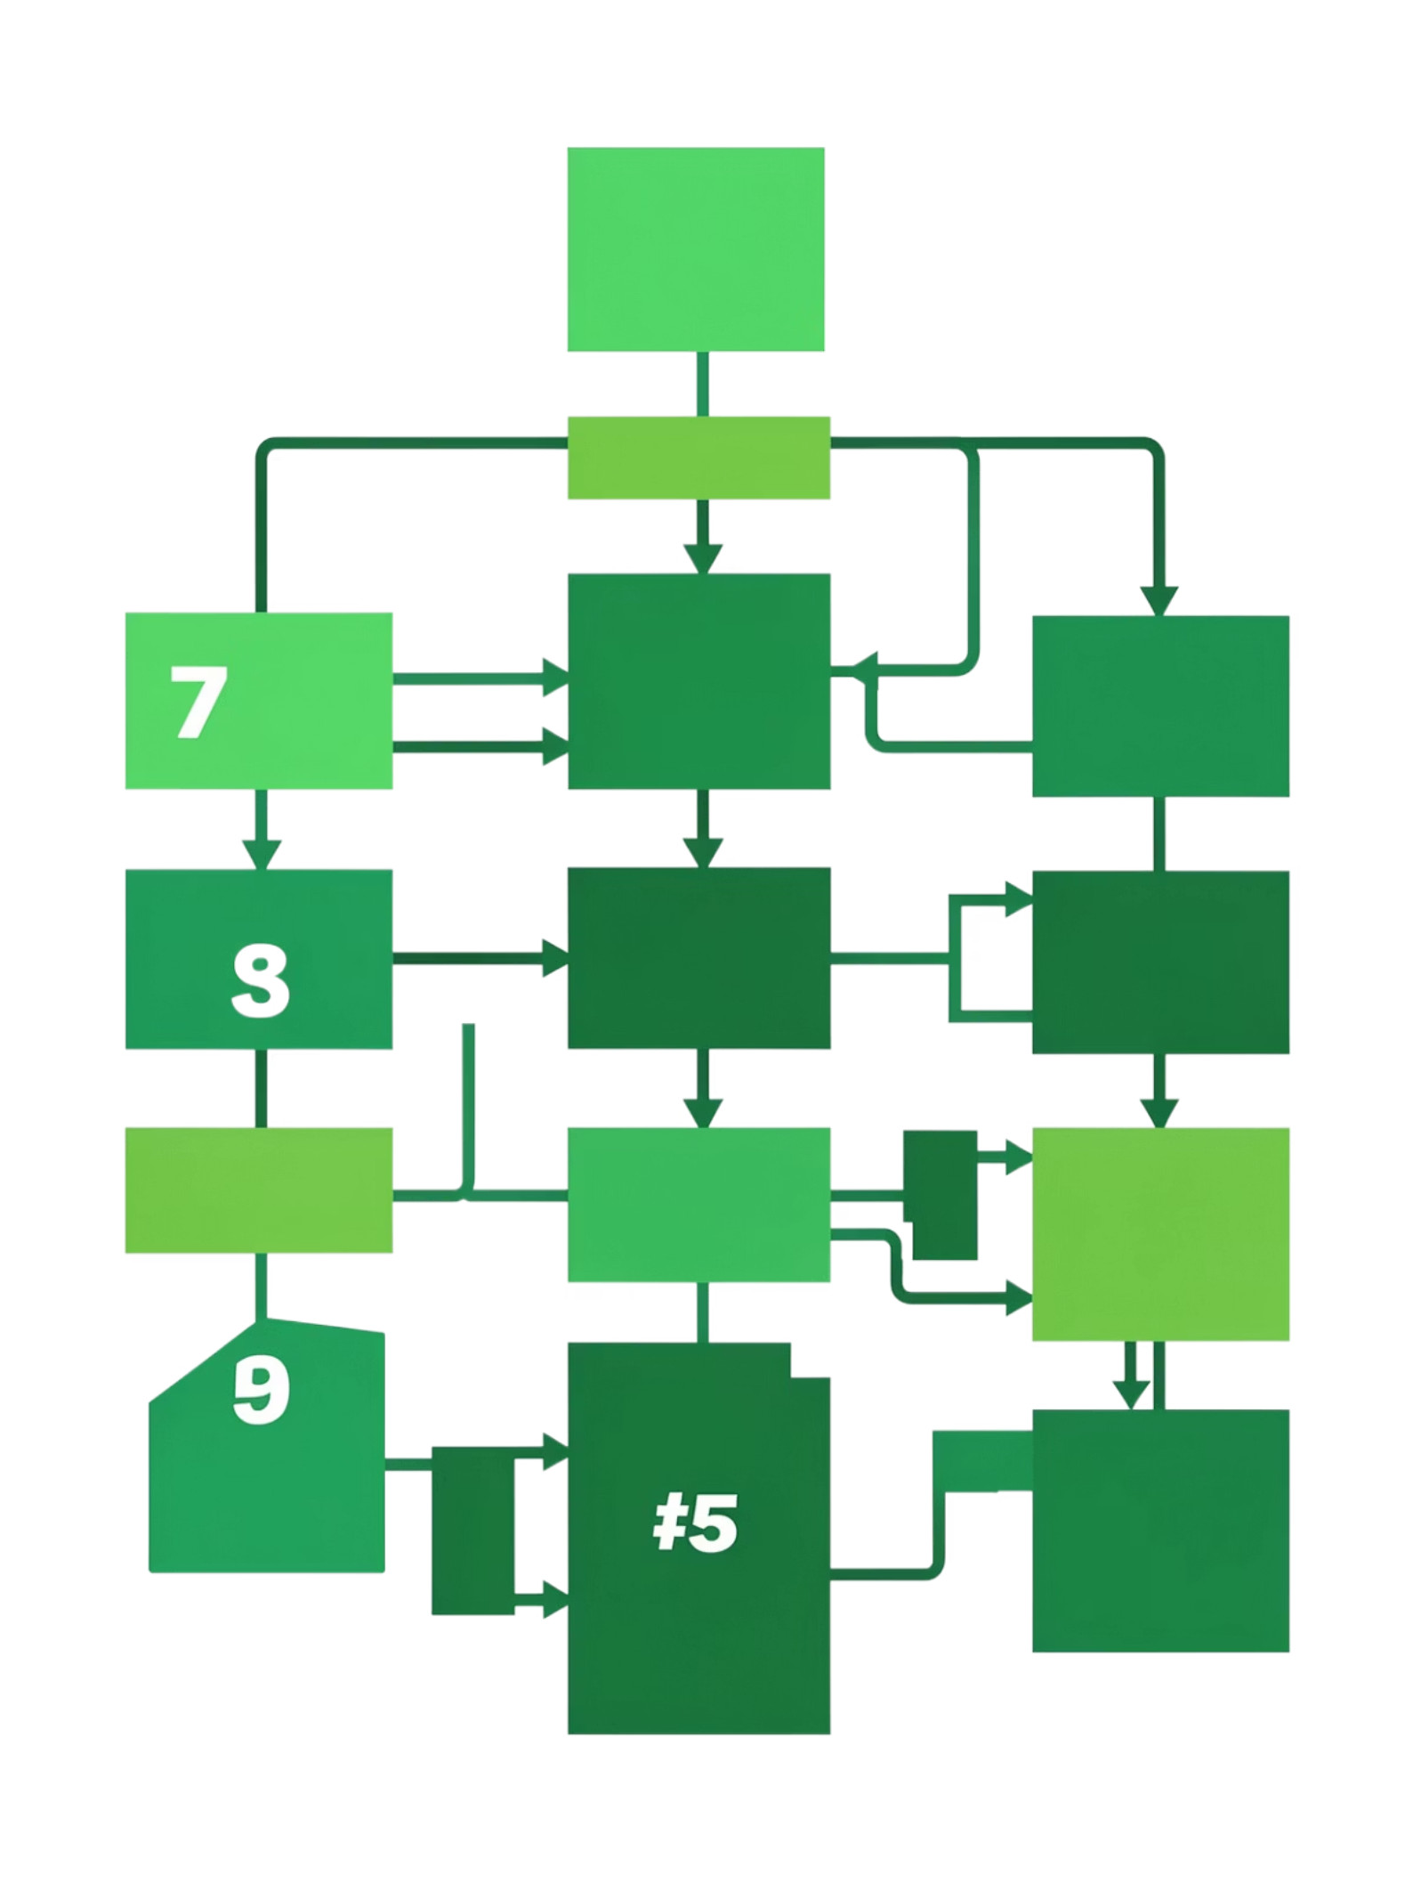


System Workflow
Mato follows a clear, auditable workflow: collect soil readings (simulated or real), process with agricultural rules, generate recommendations, and present results on a dashboard or lightweight farmer channels. Simulation uses bounded, scientifically valid ranges so prototype outputs remain realistic and defensible.
Data Validation
Recommendation Engine
Clean and normalize measurements for consistency.
Apply agricultural rules to generate advisories.
Soil Measurement
Dashboard Output
Collect simulated or field soil readings.
Present results to farmers via dashboard channels.
This is a data-driven system built on agricultural logic; simulation ≠ randomness.

Slide 4
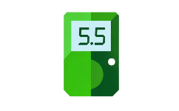

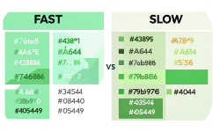
From Data to Decision — Example & Comparison
Example Input
Suggested Action
Impact
pH 5.5, low nitrogen detected — quick assessment flags acidity and N deficiency.
Recommend millet or other iron‑rich, low‑input cereals; targeted N amendment timing; liming options for acidity.
Shifts decision time from days to seconds and focuses management on nutrition as well as yield.
Metric
Traditional
NutriMap
Turnaround
3–7 days
Instant
Cost (approx)
~Rs. 2000 per test
~Rs. 100 (estimated channel cost) / free app tier
Result
Raw lab values
Actionable, crop‑specific advice

Slide 5


Sustainable Business Model & Scalability
NutriMap is built to be economically sustainable and rapidly scalable across Nepal.
Freemium for Farmers
Subsidies
Partnerships
Government taking our product in full fledge and providing it to farmer in lower cost.
Public‑private partnerships for subsidized sensor rollouts and collective sampling programs.
Free basic app and SMS advisories ensure high adoption among smallholders.
Scale Ready
Designed to accept real IoT sensor streams, expand datasets, and localize recommendations by agro-ecological zone.
Idea line: Low-cost today, scalable for tomorrow.

Slide 6
Impact, Limitations & Next Steps
Impact — Faster Decisions
Impact — Lower Cost
Quicker advisories enable timely fertilizer application and crop choice aligned with nutrition goals.
Reduced per-test cost and free basic advisories increase repeat testing and better management.
Impact — Better Nutrition
Limitation — Prototype Stage
Recommendations emphasize nutrient-dense crop choices and targeted soil amendments.
Current outputs use simulated data ranges and require on‑farm validation before widescale deployment.
Next steps: conduct field validation pilots in representative Nepali agro-ecological zones, integrate low-cost NPK/pH sensors, refine rule sets with agronomic partners, and formalize government collaboration for scale.
References: Nepal agricultural soil testing cost reports; FAO soil nutrient standards; sensor specifications for NPK/pH probes; research on biofortification and nutritious crops (millet, buckwheat).

